Slide 1
Convolutional Neural Network
Presenters: Happy & Grace

Slide 2
01
Building Blocks of CNNs
02
CNN Architecture
CONTENTS
03
LeNet
04
AlexNet
05
VGGNet
06
ResNet
07
Assignment

Slide 3
01
Building Blocks of CNN

Slide 4
01
Building blocks of CNN
Convolutional layer
Pooling Layer:
either maxpooling layer or average pooling layer
Fully connected layer
Formula for the output size: (n+2p - f)/s +1
where n = input size, p = padding, s = stride, f=filter size

Slide 5
CNN Architectures
02

Slide 6
CNN Architectures
02
LeNet
AlexNet
VGGNet (VGG 16 and VGG 19)
ResNet
InceptionNet
MobileNet
EfficientNet, etc

Slide 7
03
LeNet

Slide 8
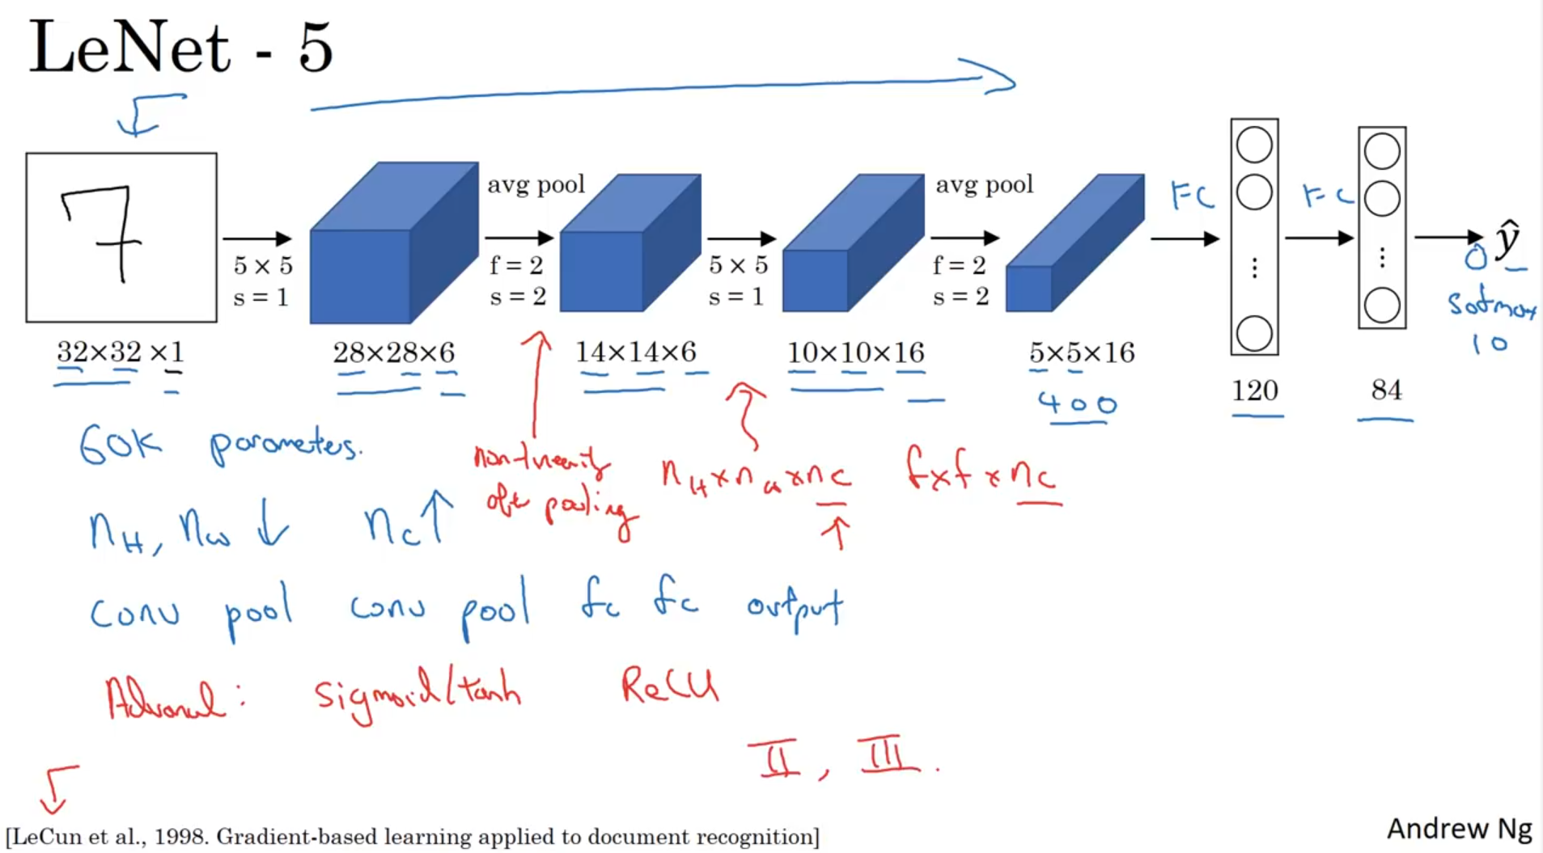
LeNet
03

Slide 9
04
AlexNet

Slide 10
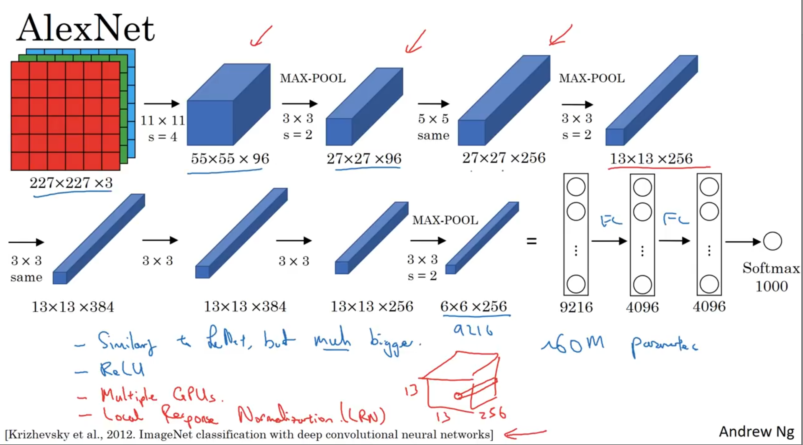
AlexNet
04

Slide 11
Let’s code together

Slide 12
05
ResNet

Slide 13
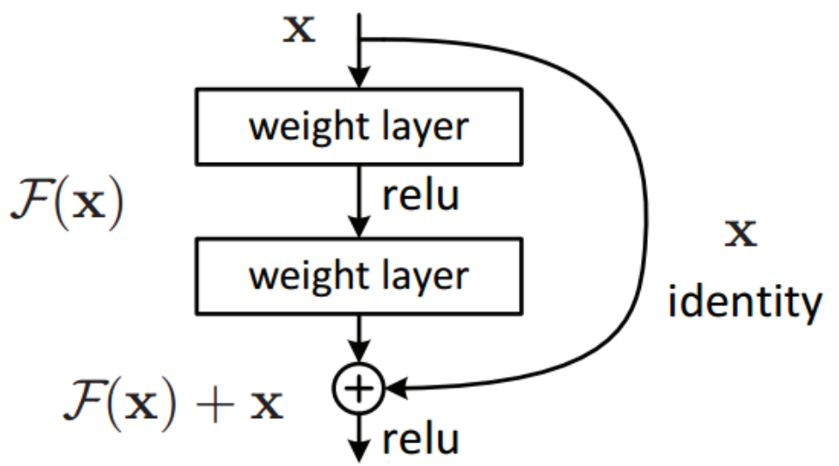
ResNet
05

Slide 14
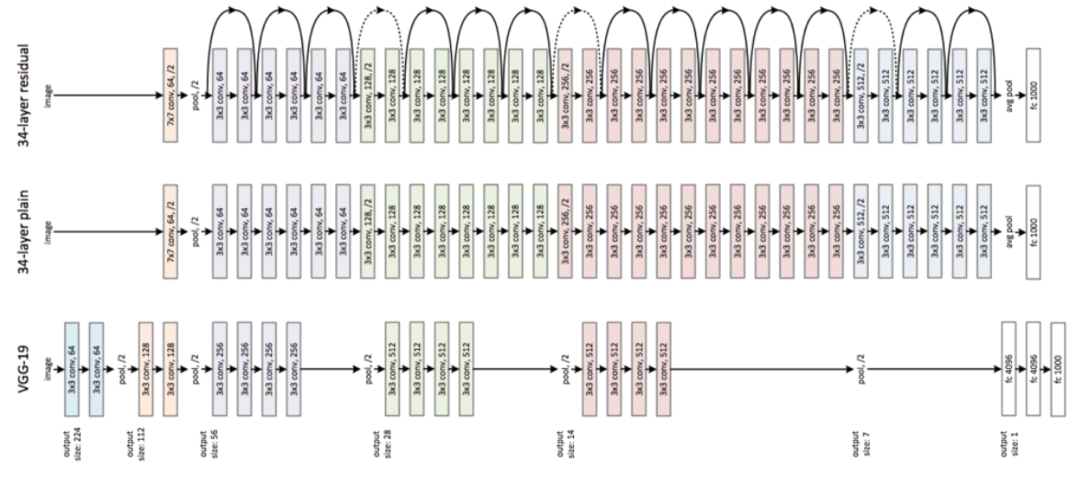
ResNet
05

Slide 15
Let’s code together

Slide 16
06
VGGNet

Slide 17
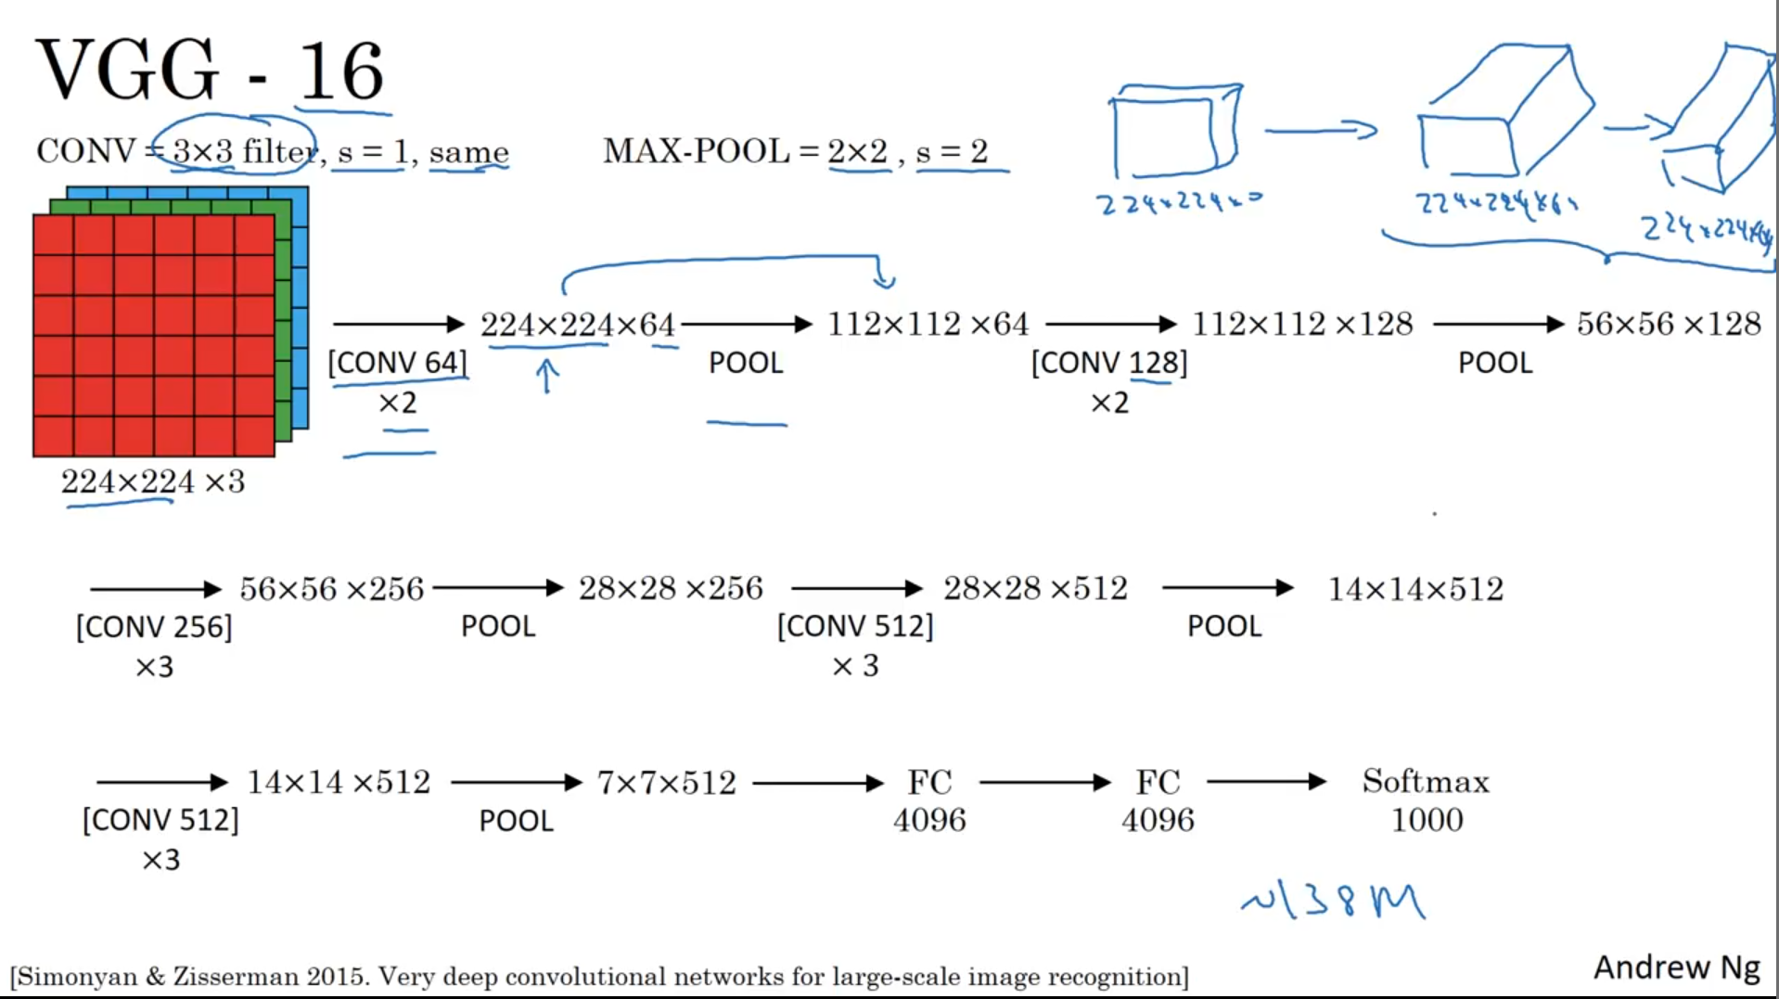
VGGNet
06

Slide 18
Assignment 2

Slide 19
VGGNet Family
06
Implement the VGG 16 network using scratch and pretrained model.
Deadline: Before next Friday Class (23/06/2023)

